Slide 1
Internetworking

Slide 2
What Is an Internetwork?
The term internetwork, or sometimes just internet with a lowercase i, to refer to an arbitrary collection of networks interconnected to provide some sort of host-to-host packet delivery service.
  For example, a corporation with many sites might construct a private internetwork by interconnecting the LANs at their different sites with point-to-point links leased from the phone company.
The widely used global internetwork to which a large percentage of networks are now connected, we call it the Internet with a capital I.
An internetwork can be defined as a collection of individual networks, connected by intermediate networking devices, that functions as a single large network.
Internetworking refers to the industry, products, and procedures that meet the challenge of creating and administering internetworks.
In modern practice, the interconnected computer networks or Internetworking use the Internet Protocol. Two architectural models are commonly used to describe the protocols and methods used in internetworking. The standard reference model for internetworking is Open Systems Interconnection (OSI).

Slide 3
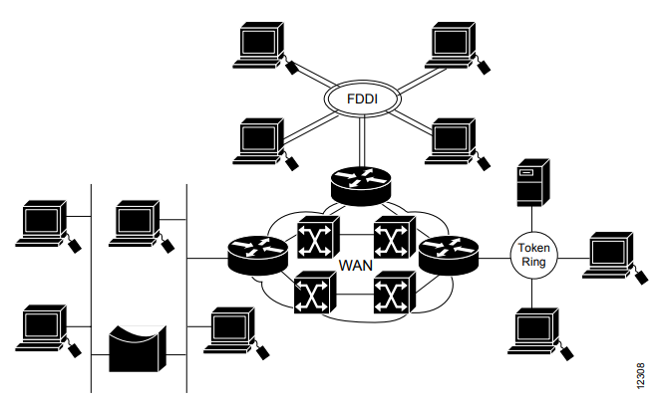
Contd.
[Different network technologies can be connected to create an internetwork]
Fiber Distributed Data Interface (FDDI)

Slide 4
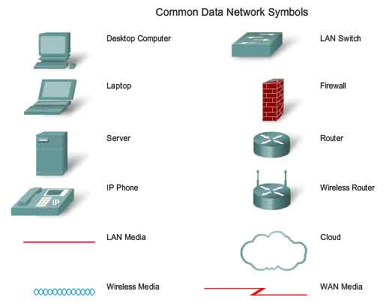
Generic symbols in Internetworking
Switch - the most common device for interconnecting local area networks
Firewall - provides security to networks
Router - helps direct messages as they travel across a network
Wireless Router - a specific type of router often found in home networks
Cloud - used to summarize a group of networking devices, the details of which may be unimportant to the discussion at hand
Serial Link/Bridge - one form of WAN interconnection, represented by the lightning bolt-shaped line

Slide 5
Internetworking Terms (1)
Communications Network
  Facility that provides data transfer service
An internet
  Collection of communications networks interconnected by bridges and/or routers
The Internet - note upper case I
  The global collection of thousands of individual machines and networks
Intranet
  Corporate internet operating within the organization
  Uses Internet (TCP/IP and http)technology to deliver documents and resources

Slide 6
Internetworking Terms (2)
End System (ES)
  Device attached to one of the networks of an internet
  Supports end-user applications or services
Intermediate System (IS)
  Device used to connect two networks
  Permits communication between end systems attached to different networks

Slide 7
Requirements of Internetworking
Link between networks
  Minimum physical and link layer
Routing and delivery of data between processes on different networks
Accounting services and status info
Independent of network architectures

Slide 8
Type of Internetworking
Internetworking is implemented in Layer 3 (Network Layer) of this model The most notable example of internetworking is the Internet (capitalized). There are three variants of internetwork or Internetworking, depending on who administers and who participates in them :
Extranet
Intranet
Internet

Slide 9
Contd.
Extranet
  An extranet is a network of internetwork or Internetworking that is limited in scope to a single organisation or entity but which also has limited connections to the networks of one or more other usually, but not necessarily, trusted organizations or entities .Technically, an extranet may also be categorized as a MAN, WAN, or other type of network, although, by definition, an extranet cannot consist of a single LAN; it must have at least one connection with an external network.
Intranet
  An intranet is a set of interconnected networks or Internetworking, using the Internet Protocol and uses IP-based tools such as web browsers and ftp tools, that is under the control of a single administrative entity. That administrative entity closes the intranet to the rest of the world, and allows only specific users. Most commonly, an intranet is the internal network of a company or other enterprise. A large intranet will typically have its own web server to provide users with browseable information.

Slide 10
Contd.
Internet
  A specific Internetworking, consisting of a worldwide interconnection of governmental, academic, public, and private networks based upon the Advanced Research Projects Agency Network (ARPANET) developed by ARPA of the U.S. Department of Defense also home to the World Wide Web (WWW) and referred to as the ‘Internet‘ with a capital ‘I’ to distinguish it from other generic internetworks. Participants in the Internet, or their service providers, use IP Addresses obtained from address registries that control assignments.

Slide 11
Network Architecture Features
Addressing
Packet size
Access mechanism
Timeouts
Error recovery
Status reporting
Routing
User access control
Connection based or connectionless

Slide 12
Architectural Approaches
In general, networking protocols and the data traffic that they support can be characterized as being either
Connection-oriented (Circuit Switched)
  connection-oriented data handling involves using a specific path that is established for the duration of a connection.
Connectionless (Packet Switched)
  Connectionless data handling involves passing data through a permanently established connection.

Slide 13
Connection Oriented
Connection-oriented service involves three phases:
  Connection establishment,
  Data transfer, and
  Connection termination.
During the connection-establishment phase, a single path between the source and destination systems is determined.
Network resources typically are reserved at this time to ensure a consistent grade of service, such as a guaranteed throughput rate.
In the data-transfer phase, data is transmitted sequentially over the path that has been established.
  Data always arrives at the destination system in the order in which it was sent.
During the connection-termination phase, an established connection that is no longer needed is terminated.
  Further communication between the source and destination systems requires that a new connection be established.

Slide 14
Contd.
Advantages
  Guaranteed delivery
  Highly reliable connection
  Reduced transmission delay
  Packet resequencing
  Disadvantages
  Difficulty in static path selection
  Efficient bandwidth utilization is less

Slide 15
Connectionless Operation
Corresponds to datagram mechanism in packet switched network.
The need for a single, reserved circuit from end-to-end does not exist in a packet switched network.
Any piece of a message can be sent through the network using any available path.
Packets containing pieces of messages from different sources can travel the network at the same time.
The problem of underutilized or idle circuits is eliminated -- all available resources can be used at any time to deliver packets to their final destination.
By providing a method to dynamically use redundant paths, without intervention by the user, the Internet has become a fault tolerant, scalable method of communications.
The premise for this type of networks is that a single message can be broken into multiple message blocks.
  Individual blocks containing addressing information indicate both their origination point and their final destination.
  Using this embedded information, these message blocks, called packets, can be sent through the network along various paths, and can be reassembled into the original message upon reaching their destination.

Slide 16
Contd.
Advantages
  Flexibility
  Robust
  No unnecessary overhead
  Disadvantages
  Not guaranteed delivery
  Not guaranteed order of delivery
    Packets can take different routes
  Reliability is responsibility of next layer up (e.g. TCP)

Slide 17
Internetwork Addressing
Internetwork addresses identify devices separately or as members of a group.
Addressing schemes vary depending on the protocol family and the OSI layer.
A structured numbering system is used in Internetworking.
  Hosts that are connected to the same physical network have “similar” IP addresses.
  Often more then one level of structure; e.g. physical networks in the same organisation use “similar” IP addresses.
Three types of internetwork addresses are commonly used:
  Data-link layer addresses,
  Media Access Control (MAC) addresses
  Network-layer addresses.

Slide 18
Contd.
  Data Link Layer
A data-link layer address uniquely identifies each physical network connection of a network device. Data-link addresses sometimes are referred to as physical or hardware addresses.
End systems generally have only one physical network connection, and thus have only one data-link address.
Routers and other internetworking devices typically have multiple physical network connections and therefore also have multiple data-link addresses.
  Network-Layer Addresses
A network-layer address identifies an entity at the network layer of the OSI layers. Network addresses usually exist within a hierarchical address space and sometimes are called virtual or logical addresses.

Slide 19
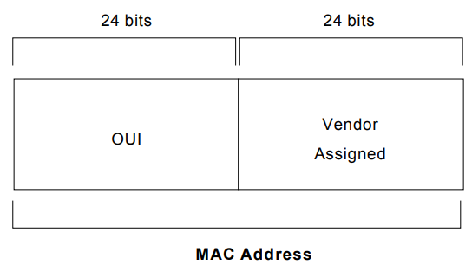
Contd.
  Media Access Control (MAC) addresses
MAC addresses identify network entities in LANs that implement the IEEE MAC addresses of the data-link layer.
MAC addresses are 48 bits in length and are expressed as 12 hexadecimal digits. The first 6 hexadecimal digits, which are administered by the IEEE, identify the manufacturer or vendor and thus comprise the Organizational Unique Identifier (OUI). The last 6 hexadecimal digits comprise the interface serial number, or another value administered by the specific vendor. MAC addresses sometimes are called burned-in addresses (BIAs) because they are burned into read-only memory (ROM) and are copied into random-access memory (RAM) when the interface card initializes.

Slide 20
Purpose of an IP Address
Identifies a machine’s connection to a network
Physically moving a machine from one network to another requires changing the IP address
Unique; assigned in a hierarchical fashion
  IANA (Internet Assigned Number Authority)
  IANA to RIRs (Regional Internet Registries)
  RIR to ISPs (Internet Service Provider) and large organisations
  ISP or company IT department to end users
IPv4 uses unique 32-bit addresses
IPv6 used similar concepts but 128-bit addresses

Slide 21
Internetworking Challenges
Implementing a functional internetwork is no simple task. Many challenges must be faced, especially in the areas of connectivity, reliability, network management, and flexibility. Each area is key in establishing an efficient and effective internetwork.
The challenge when connecting various systems is to support communication between disparate technologies.
Another essential consideration, reliable service, must be maintained in any internetwork.
Individual users and entire organizations depend on consistent, reliable access to network resources.
Furthermore, network management must provide centralized support and troubleshooting capabilities in an internetwork.
Configuration, security, performance, and other issues must be adequately addressed for the internetwork to function smoothly. Flexibility, the final concern, is necessary for network expansion and new applications and services, among other factors.

Slide 22
Design Issues
Routing
Datagram lifetime
Fragmentation and re-assembly
Error control
Flow control

Slide 23
Routing
End systems and routers maintain routing tables
  Indicate next router to which datagram should be sent
  Static
    May contain alternative routes
  Dynamic
    Flexible response to congestion and errors
Source routing
  Source specifies route as sequential list of routers to be followed
  Security
  Priority
Route recording

Slide 24
Datagram Lifetime
Datagrams could loop indefinitely
  Consumes resources
  Transport protocol may need upper bound on datagram life
Datagram marked with lifetime
  Time To Live field in IP
  Once lifetime expires, datagram discarded (not forwarded)
  Hop count
    Decrement time to live on passing through a each router
  Time count
    Need to know how long since last router
(Aside: compare with Logan’s Run)

Slide 25
Fragmentation and
Re-assembly
Different packet sizes
When to re-assemble
  At destination
    Results in packets getting smaller as data traverses internet
  Intermediate re-assembly
    Need large buffers at routers
    Buffers may fill with fragments
    All fragments must go through same router
      Inhibits dynamic routing

Slide 26
IP Fragmentation (1)
IP re-assembles at destination only
Uses fields in header
  Data Unit Identifier (ID)
    Identifies end system originated datagram
      Source and destination address
      Protocol layer generating data (e.g. TCP)
      Identification supplied by that layer
  Data length
    Length of user data in octets

Slide 27
IP Fragmentation (2)
  Offset
    Position of fragment of user data in original datagram
    In multiples of 64 bits (8 octets)
  More flag
    Indicates that this is not the last fragment

Slide 28
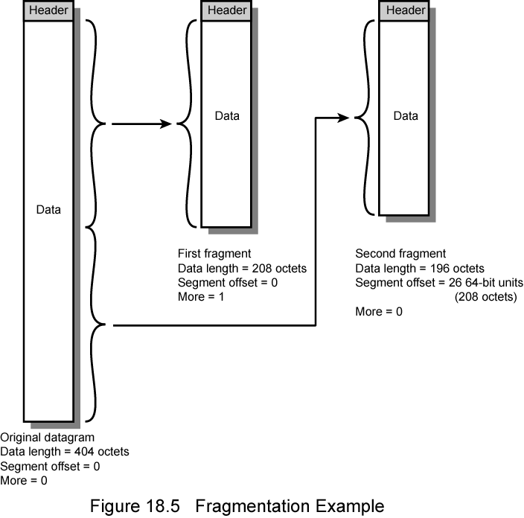
Fragmentation Example

Slide 29
Dealing with Failure
Re-assembly may fail if some fragments get lost
Need to detect failure
Re-assembly time out
  Assigned to first fragment to arrive
  If timeout expires before all fragments arrive, discard partial data
Use packet lifetime (time to live in IP)
  If time to live runs out, kill partial data

Slide 30
Error Control
Not guaranteed delivery
Router should attempt to inform source if packet discarded
  e.g. for time to live expiring
Source may modify transmission strategy
May inform high layer protocol
Datagram identification needed
(Look up ICMP)

Slide 31
Flow Control
Allows routers and/or stations to limit rate of incoming data
Limited in connectionless systems
Send flow control packets
  Requesting reduced flow
e.g. ICMP

Slide 32
Queries

